Slide 1
FINAL PROJECT: Classification and Regression on Wine Quality Dataset
Presented by
Cazan Alexia Ioana

Slide 2
Introduction
The project was done on the white wine dataset (winequality-white.csv);
2 classification models:
  Logistic Regression
  KNN
2 regression models:
  Ridge Regression
  KNN Regression

Slide 3
Project Outline
Part 1: Exploratory Data Analysis
  In this step of the project, I analysed the data in order to establish which models to use and how to adapt them to the nature of the data.
Part 2: Classification Task
  Building the classification models and comparing their performance.
Part 3: Regression Task
  Building the regression models and comparing their performance, as well as comparing the performance and suitability of regression and classification models for the given dataset.

Slide 4
Part 1: Exploratory Data Analysis
This part of the project tried to answer the following questions:
Is the dataset balanced or imbalanced? Models tend to be affected by the imbalance in the dataset → classification
How is data distributed? Are features linearly separable based on the class? → classification
Are there any correlated features? This might affect the performance of the models: for linear algorithms, multicollinearity can cause the coefficients of the correlated features to become unstable, while for KNN correlated features can affect distances: if two features are highly correlated, the “distance” between points might be dominated by those correlated dimensions, giving them more influence than they should have. → classification and regression
Is there a linear relationship between the features and the target? This shows if the relationship between features and the "continuous" target is better modelled using a linear model or a non-linear one. → regression
Notes:
Example objectives
At the end of this lesson, you will be able to:
Save files to the team Web server.
Move files to different locations on the team Web server.
Share files on the team Web server.

Slide 5
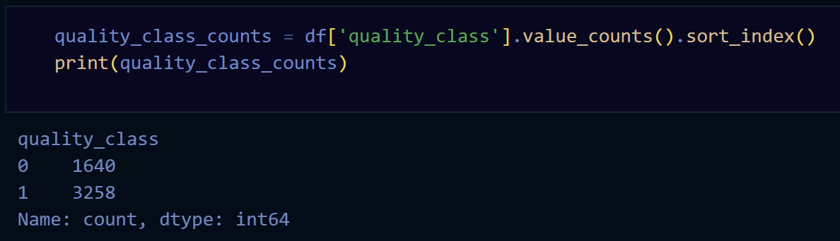
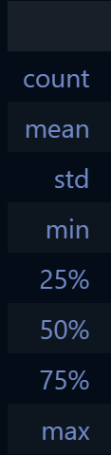
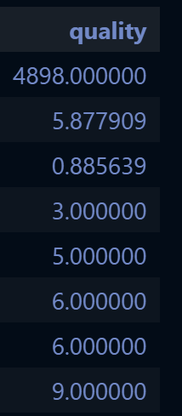
Part 1: Is the dataset balanced or imbalanced?
Imbalanced dataset
To deal with the imbalance in the data, when I engineered the target for the classification task (based on the original target quality), I set its threshold to the median value of quality.

Slide 6
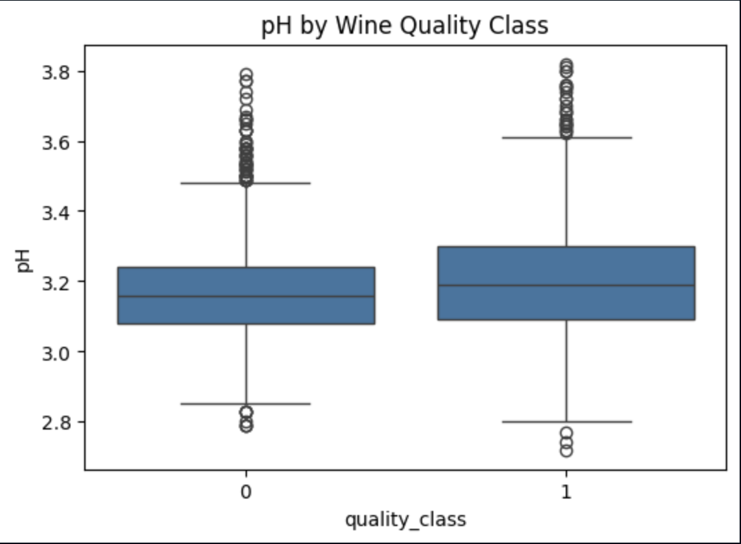
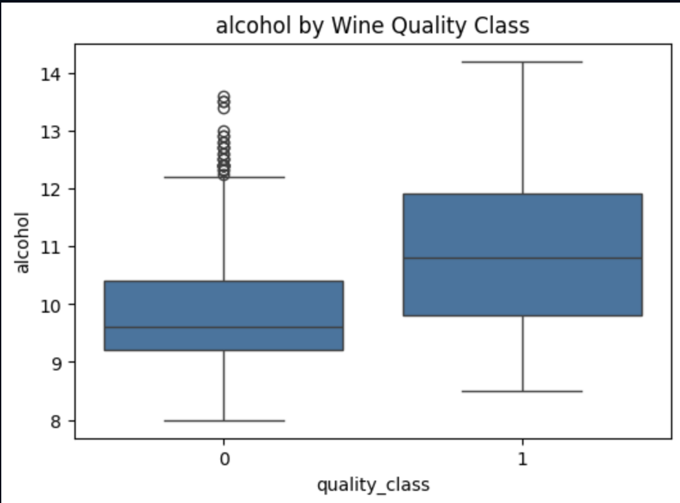
Part 1: How is data distributed?
Boxplots representing the distribution of each feature for each of the 2 classes: good wine vs. bad wine.
For most of the boxplots:
  the medians are close
  interquartile ranges overlap a lot
  there is no clear gap between the two classes
→ This indicates that the classes might not be clearly separable using simple linear boundaries based on individual features, meaning that linear models like Logistic Regression may struggle to fully capture the class structure, while models that can handle more complex decision boundaries, such as KNN, may be better suited for this task.

Slide 7
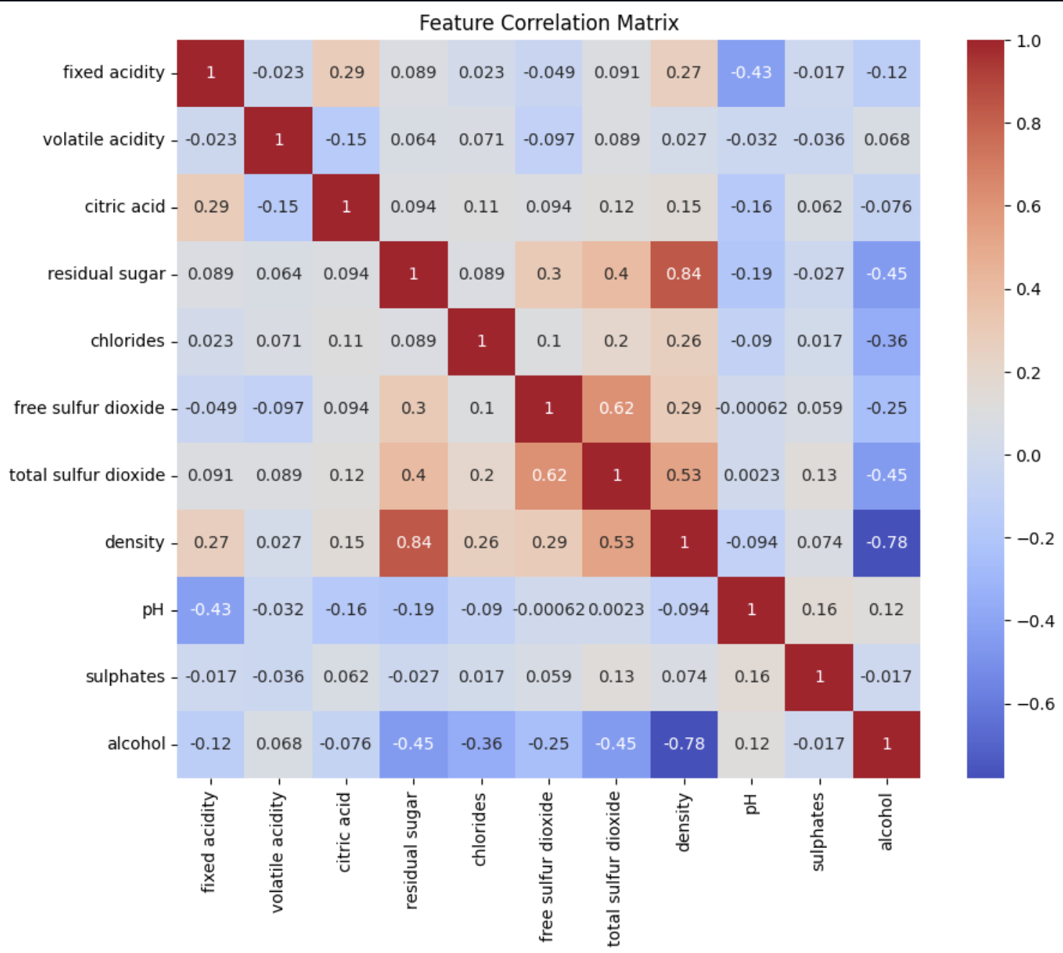
Part 1: Are there any correlated features?
Correlations above 0.7 can be considered indicative of strong linear relationships between features, which may lead to multicollinearity in linear models such as Logistic Regression.
A strong correlation was observed between residual sugar and density
→ Since the objective is to compare the performance of the models rather than interpret individual coefficients, and both models are trained on the same feature set for fairness, I kept both features.

Slide 8
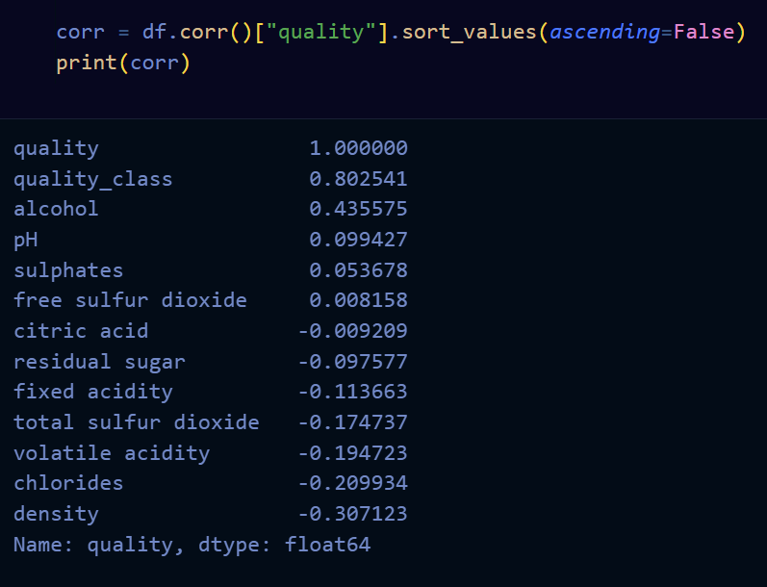
Part 1: Is there a linear relationship between the features and the target?
I computed Pearson correlation coefficients between the target and each feature, which measure linear relationships
it can be observed that the relationships between the features and the quality target are very weak.
→ Thia means that for regression, a linear model wouldn't perform very well since it requires linear relations between features and the target.

Slide 9
Part 2: Classification task
Data Splitting:
  Initial split: Train + Validation set, Test set → The split is done in a stratified manner, meaning that the proportion of good and not-good wines is preserved in both subsets;
  Test set is put aside and only used at the end, once;
  The Train + Validation subset is k-fold cross-validation with GridSearchCV during hyperparameter tuning.
Trained models:
  Logistic Regression
  KNN
Training:
  Initial training, default parameters → initial performance
  Hyperparameter tuning → best parameters are used on the test set
Weighting was added for both models to deal with the imbalance between classes
Evaluation: 4 metrics for easier comparison between models:
  Accuracy shows the overall proportion of correctly classified samples.
  Precision measures how many of the wines predicted as “good” are actually good.
  Recall indicates how many of the truly good wines were correctly identified by the model.
  F1-score combines precision and recall into a single metric, making it especially useful for this task since the dataset is imbalanced.
Notes:
The function returns the following metrics together for easier comparison between models:
* Accuracy shows the overall proportion of correctly classified samples.
* Precision measures how many of the wines predicted as “good” are actually good.
* Recall indicates how many of the truly good wines were correctly identified by the model.
* F1-score combines precision and recall into a single metric, making it especially useful for this task since the dataset is imbalanced.

Slide 10
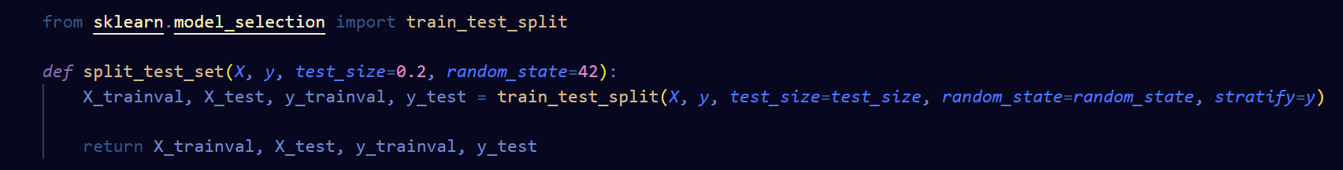
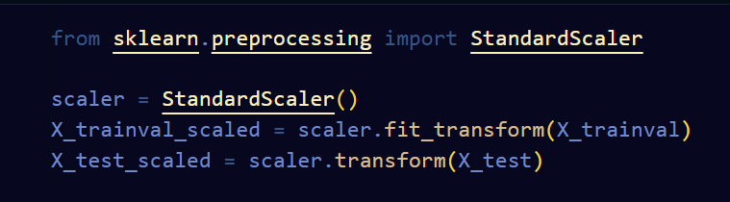
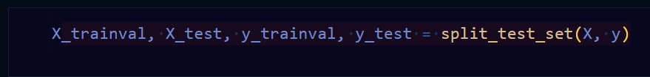
Part 2: Data Splitting and Scaling
Before training the models, the features are standardized using StandardScaler. This scaling process transforms each feature so that it has a mean of 0 and a standard deviation of 1. Feature scaling is important because the variables in the wine dataset are measured on different scales (for example, alcohol content and acidity), and models that rely on distances or optimization, such as KNN and Logistic Regression, can be strongly affected by these differences.

Slide 11
Part 2: Training
logistic_model and knn_model → train a model using a set of default hyperparameters → initial experiments with random starting parameters
logistic_tuning and knn_tuning → hyperparameter tuning for Logistic Regression and KNN using GridSearchCV combined with k-fold cross-validation: A grid of possible values for the hyperparameters; for each combination of hyperparameters, the model is trained and evaluated across multiple folds, and the average F1-score is computed.
The F1-score is used as the optimization metric because it provides a balanced evaluation of precision and recall, which is important for this imbalanced dataset.
After testing all combinations, the function returns the model with the best-performing hyperparameters along with the selected parameter values.

Slide 12
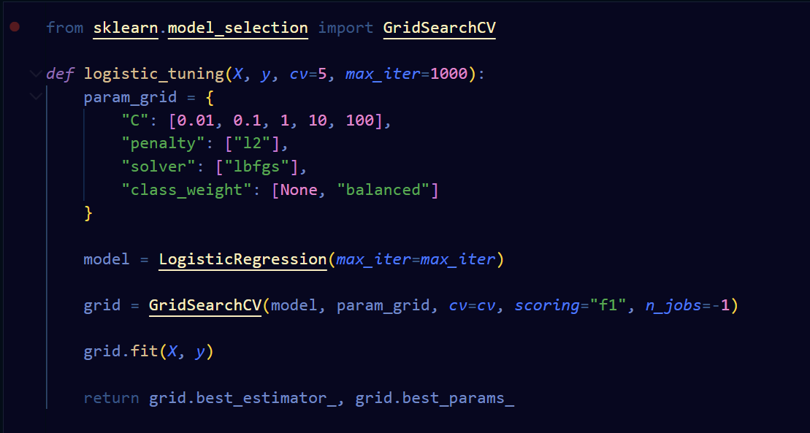
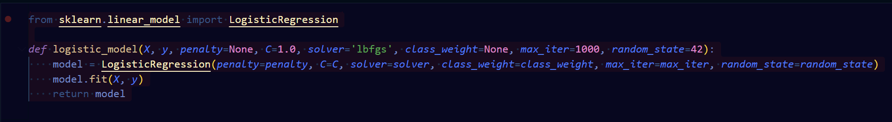
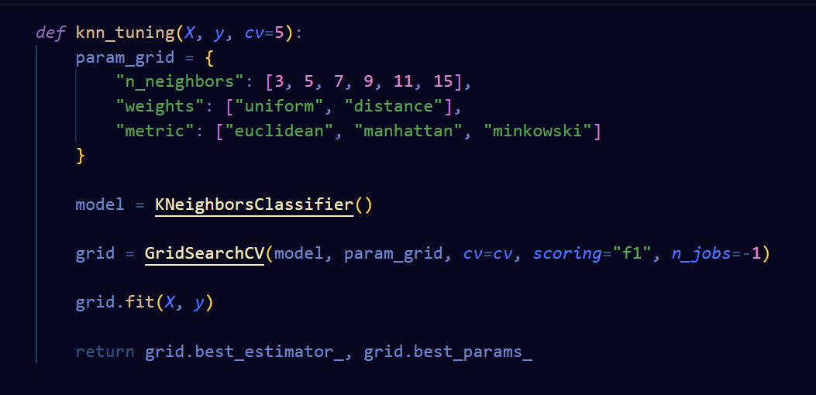
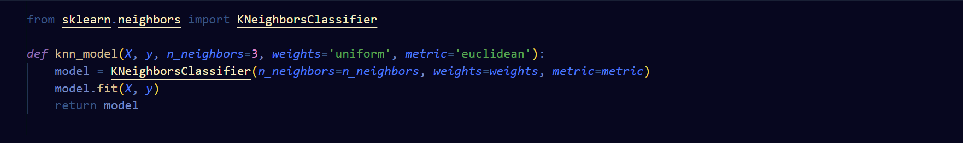
Part 2: Training
Notes:
Type: string ('l1', 'l2', 'elasticnet', or None)
Purpose: regularization method (helps prevent overfitting)
'l1'Lasso → can shrink some coefficients to zero → feature selection
'l2'Ridge → penalizes large coefficients → keeps all features
'elasticnet'combination of L1 + L2
Noneno regularization
Purpose: strength of regularization inverse
C large → weaker regularization (model can fit more)
C small → stronger regularization (model simpler)
solver='lbfgs'
Type: string
Purpose: the optimization algorithm used to find the best coefficients
'lbfgs'Default, works well for L2 and most datasets
'liblinear'Small datasets, supports L1 penalty
'sag' / 'saga'Large datasets, faster for many samples
'newton-cg'Works with L2, slower but stable

Slide 13
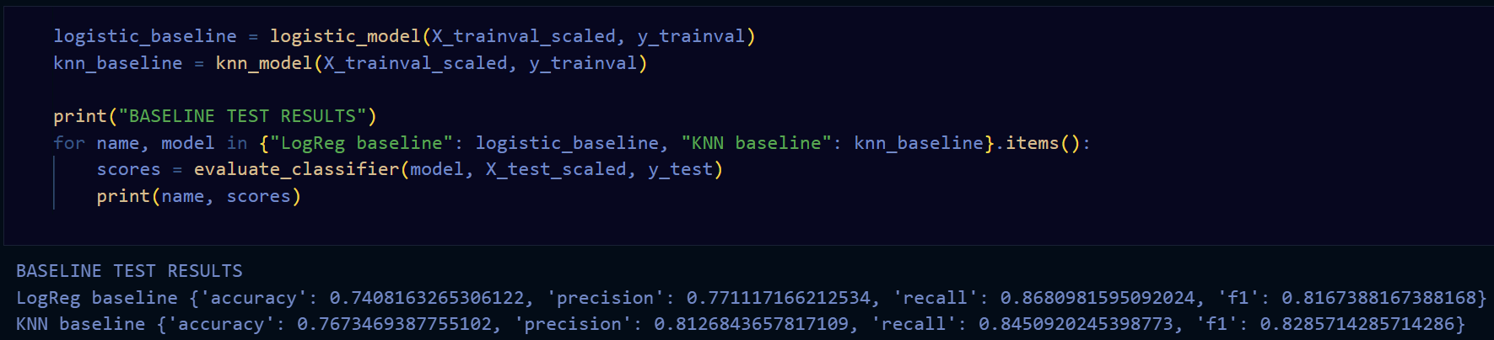
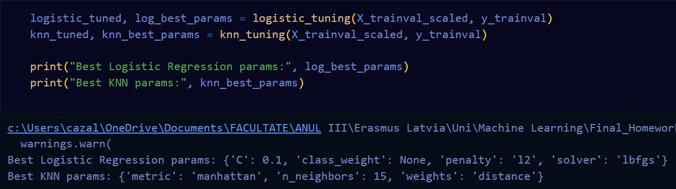
Part 2: Training

Slide 14
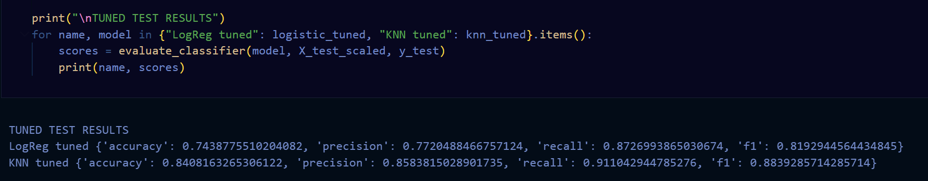
Part 2: Testing
Logistic Regression: the initial model with default parameters had already a good performance (F1-score and Accuracy). After introducing class weighting and tuning the hyperparameters, the F1-score improved only slightly, as it depends very much on whether the classes are linearly separable (and as I have found in the EDA phase, they tend to overlap).
K-Nearest Neighbours (KNN): the model benefited from its distance-based, non-linear approach. Initially, it already outperformed Logistic Regression in detecting good wines, and after tuning hyperparameters such as the number of neighbours and weighting, both its F1-score and accuracy increased. Because KNN can naturally handle nonlinear boundaries and emphasize minority-class samples through distance weighting, it is better suited for this dataset, especially given the imbalance.
Overall, KNN showed the best performance in balancing precision and recall. The improvements in F1-score for both models highlight the importance of accounting for class imbalance, but KNN’s flexible, distance-based approach makes it more effective at identifying good-quality wines in this dataset.

Slide 15
Part 3: Regression Task
Data Splitting:
  Initial split: Train + Validation set, Test set (not stratified)
  Test set is put aside and only used at the end, once;
  The Train + Validation subset is k-fold cross-validation with GridSearchCV during hyperparameter tuning.
Trained models:
  Ridge Regression
  KNN Regression
Training:
  Initial training, default parameters → initial performance
  Hyperparameter tuning → best parameters are used on the test set
Evaluation: 4 metrics for easier comparison between models:
  MAE (Mean Absolute Error): Measures the average absolute difference between the predicted and actual values. Lower MAE means the model’s predictions are closer to the true values.
  MSE (Mean Squared Error): Measures the average squared difference between predictions and actual values. It penalizes larger errors more than smaller ones, so it highlights models that occasionally make big mistakes.
  RMSE (Root Mean Squared Error): The square root of MSE. It is in the same units as the target variable and also penalizes large errors, giving a sense of typical prediction error magnitude.
  R² (R-squared score): Indicates how much of the variation in the target variable is explained by the model. Values closer to 1 mean the model explains most of the variance, while values near 0 mean the model barely improves over simply predicting the mean.
Notes:
`Ridge Regression` is a linear model that estimates the continuous wine quality score by finding a weighted combination of features while penalizing large coefficients through regularization (alpha). This helps reduce overfitting and keeps the model stable when features are correlated (as observed in the EDA phase of the project). It is simple, interpretable, and works well when the relationship between features and the target is roughly linear.
`MAE (Mean Absolute Error)`: Measures the average absolute difference between the predicted and actual values. Lower MAE means the model’s predictions are closer to the true values.
`MSE (Mean Squared Error)`: Measures the average squared difference between predictions and actual values. It penalizes larger errors more than smaller ones, so it highlights models that occasionally make big mistakes.
`RMSE (Root Mean Squared Error)`: The square root of MSE. It is in the same units as the target variable and also penalizes large errors, giving a sense of typical prediction error magnitude.
`R² (R-squared score)`: Indicates how much of the variation in the target variable is explained by the model. Values closer to 1 mean the model explains most of the variance, while values near 0 mean the model barely improves over simply predicting the mean.

Slide 16
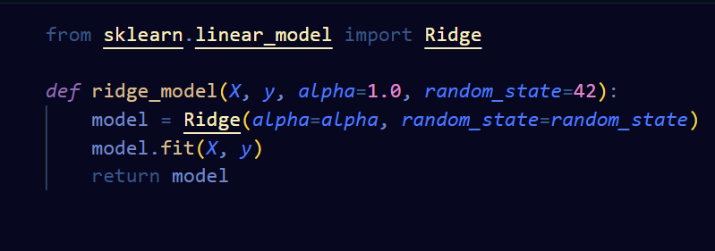
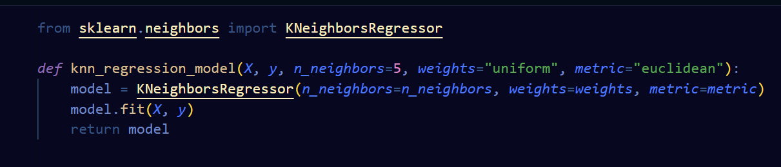
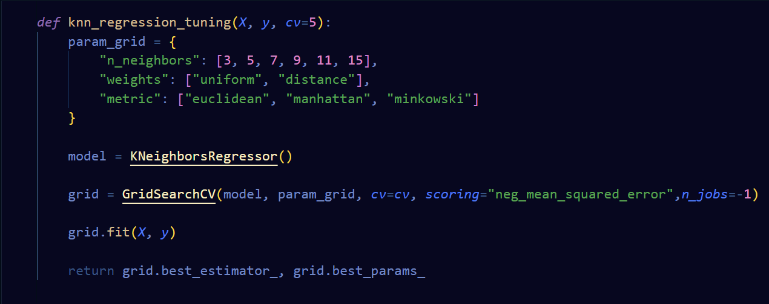
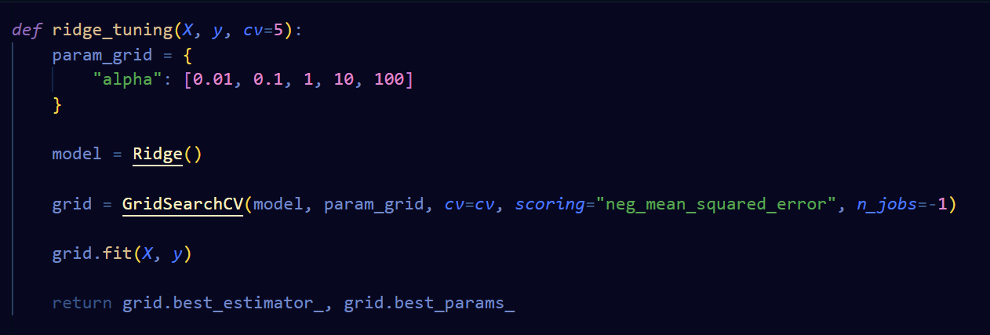
Part 2: Training
Notes:
α = regularization strength

Slide 17
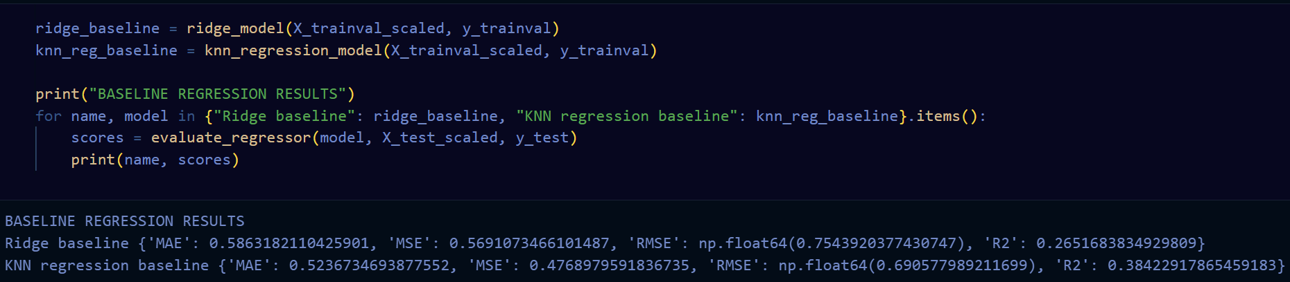
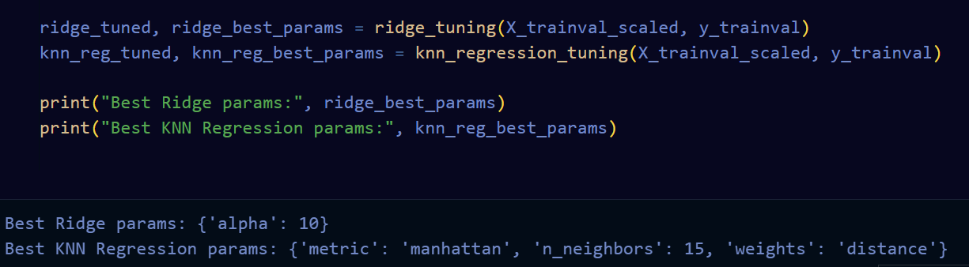
Part 2: Training

Slide 18
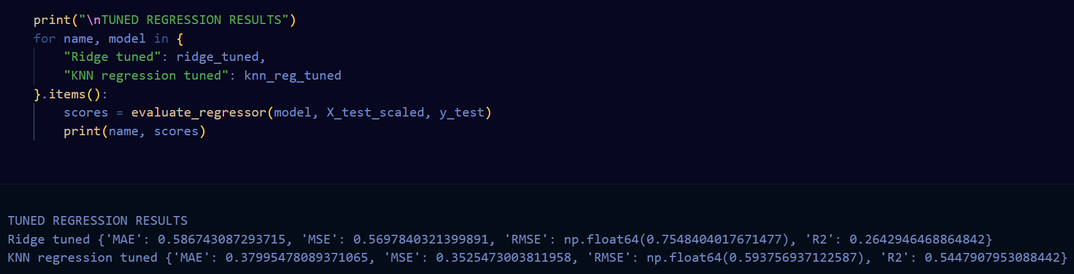
Part 2: Testing
In this regression task, we compared Ridge Regression and KNN Regression to predict wine quality. Ridge, being a linear model, performed poorly and tuning barely improved it. This makes sense because, as we saw in EDA, there isn’t a strong linear relationship between the features and the quality, so a linear model can’t capture the patterns well. Ridge does help with multicollinearity, but that wasn’t the main issue here.
KNN Regression, which can model nonlinear relationships, performed much better. Tuning the number of neighbours and using distance-based weighting improved its performance, showing how flexible models can better adapt to the data.

Slide 19
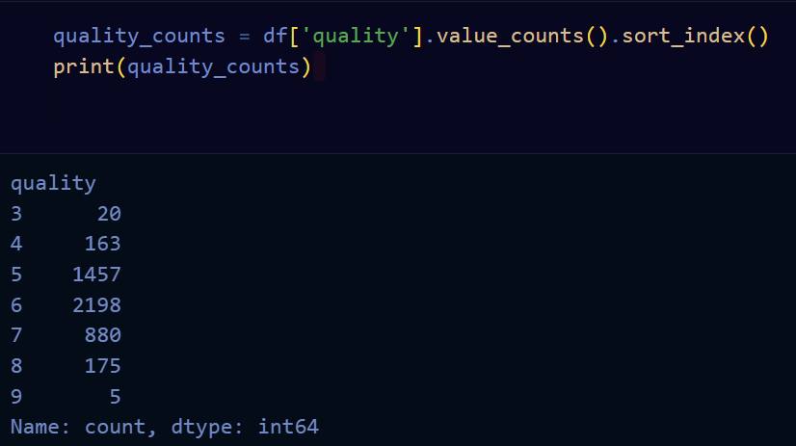
Part 3: Limitation of the regression task for this dataset
Both models in the regression task are limited by the nature of the target: wine quality isn’t truly continuous, but rather discrete—it only takes integer values from 3 to 9. This makes it harder for regression to predict perfectly, no matter how well the model is tuned.

Slide 20
Conclusion
Classification (“good” vs “not good” wines) is more suitable for this dataset. It matches the way the data is structured and allows models to perform better. So even though distance-based algorithms work better than linear ones in both tasks, regression in general struggles here due to the discrete nature of the target.

